Slide 1

INTRODUCTION TO COMPUTER SCIENCE (3 UNITS; AUD) CSC 111
Course Coordinator: D. N. Choji & C. I Eke
Other Course Lecturer(s): P. Ochang & U. M Bako
Course Assistance: T. O. Adeogun

Slide 2
TOPIC: Computer Communications and Networks

Slide 3
Outline
• Communications
• Sending and receiving devices
• Uses of communications technologies
• Networks
• Communications software
• Telephone network
• Communications devices
• Communications channel
• Physical transmission media
• Wireless transmission media

Slide 4
Communications
Computer communications describes a process in which two or more computers or devices transfer data, instructions, and information
Sending device
Communications channel
Receiving device
Page 460

Slide 5
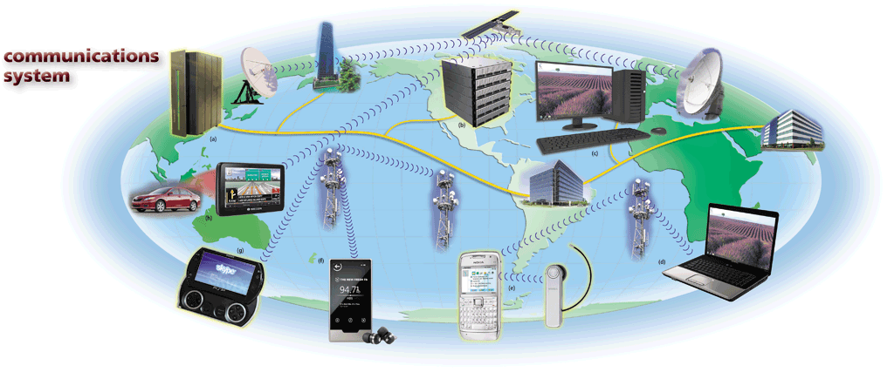
Communications
Pages 460 – 461
Figure 9-1

Slide 6
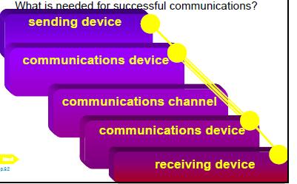
Components of Computer Communications

Slide 7
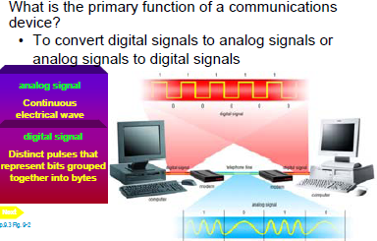
Communication Devices

Slide 8
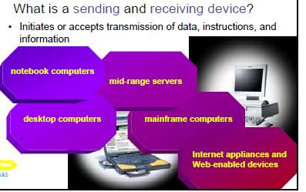
Sending and Receiving Devices

Slide 9
Uses of Computer Communications
Blogs
Chat rooms
E-mail
Fax
FTP
Instant messaging
Internet
Newsgroups
RSS
Video conferencing
VoIP
Web
Web 2.0
Web folders
Wikis
Page 462

Slide 10
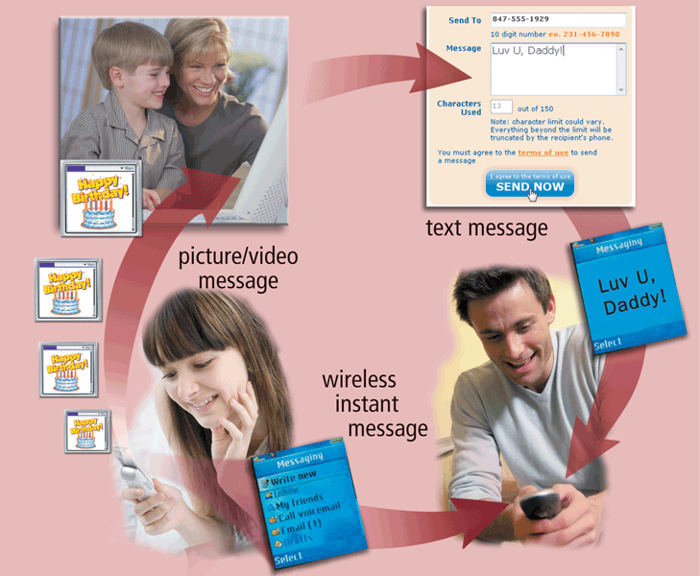
Uses of Computer Communications
Users can send and receive wireless messages using wireless messaging services
Pages 462 – 463
Figure 9-3

Slide 11
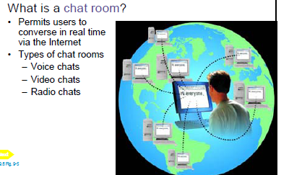
Uses of Computer Communication

Slide 12
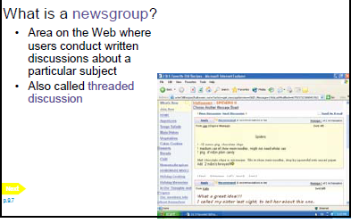
Uses of Computer Communications

Slide 13
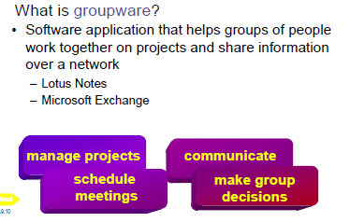
Uses of Computer Communications

Slide 14
Uses of Computer Communications
Text messaging (SMS) allows users to send and receive short text messages on a phone or other mobile device or computer
Picture messaging allows users to send pictures and sound files
Video messaging allows users to send short video clips
Wireless instant messaging allows wireless users to exchange real-time messages with one or more other users
Pages 463 - 464

Slide 15
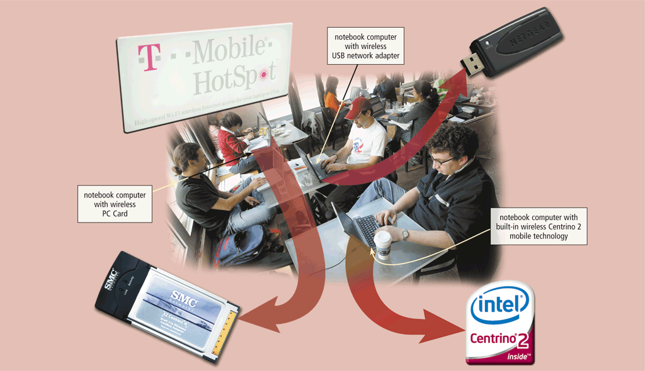
Uses of Computer Communications
Wireless Internet access points allow people to connect wirelessly to the Internet from home, work, school, and in many public locations
Pages 464 – 465
Figure 9-4

Slide 16
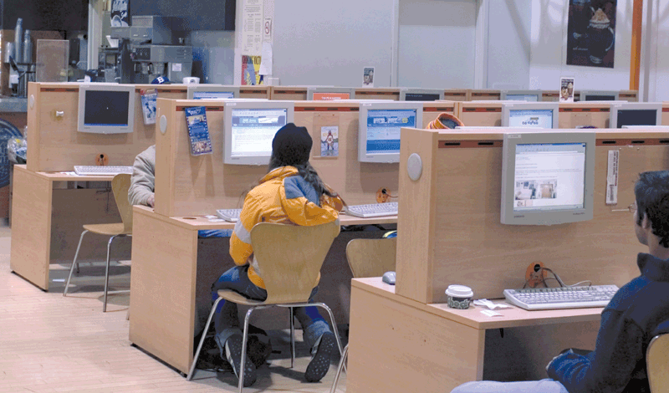
Uses of Computer Communications
A cybercafé is a coffeehouse, restaurant, or other location that provides personal computers with Internet access to its customers
Page 466
Figure 9-5

Slide 17
Uses of Computer Communications
A global positioning system (GPS) is a navigation system that consists of one or more earth-based receivers that accept and analyze signals sent by satellites in order to determine the GPS receiver’s geographic location
GPS receivers are:
Built into many mobile devices
Available as a handheld device
Available with new vehicles
Page 466

Slide 18
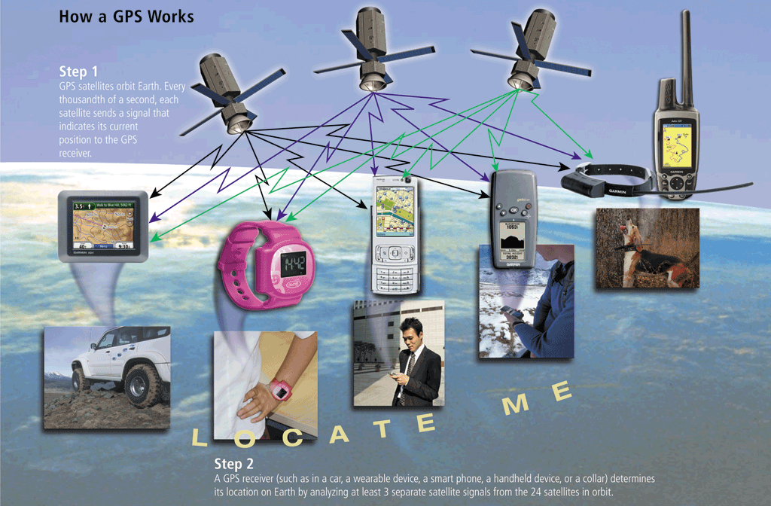
Uses of Computer Communications
Page 467
Figure 9-6

Slide 19
Uses of Computer Communications
Many programs provide a means to collaborate, or work online, with other users connected to a server
Collaboration software includes tools that enable users to share documents via online meetings and communicate with other connected users
Online meetings
Web conferences
Document management systems
Page 468

Slide 20
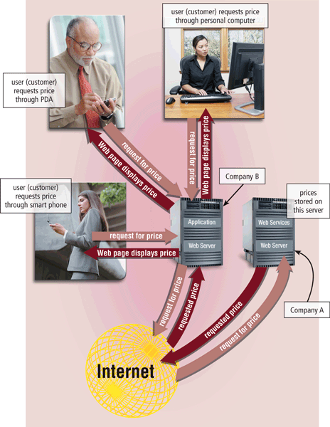
Uses of Computer Communications
Web services enable programmers to create applications that communicate with other remote computers over the Internet or on an internal business network
A mashup is a Web application that combines services from two or more sources
Page 469
Figure 9-8

Slide 21
Networks
A network is a collection of computers and devices connected together via communications devices and transmission media
Advantages of a network include:
Facilitating communications
Sharing hardware
Sharing data and information
Sharing software
Transferring funds
Pages 470 - 471

Slide 22
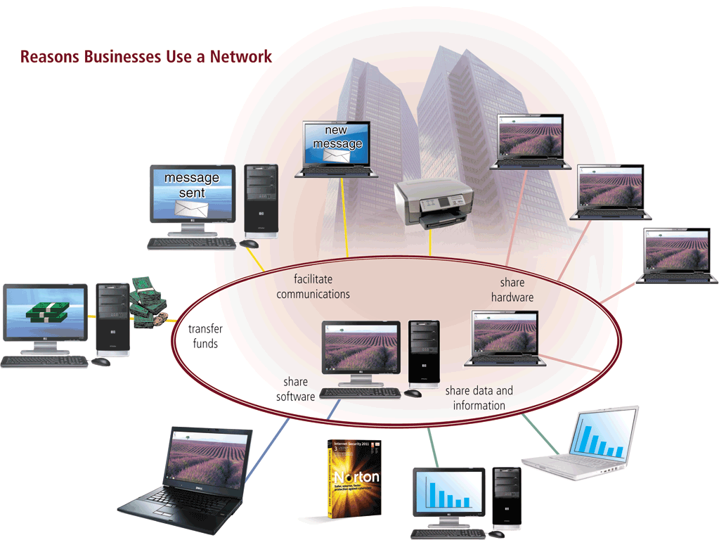
Networks
Page 470
Figure 9-9

Slide 23
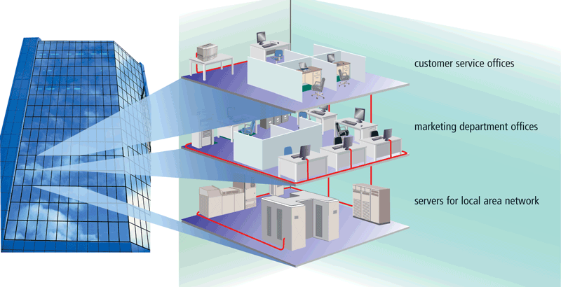
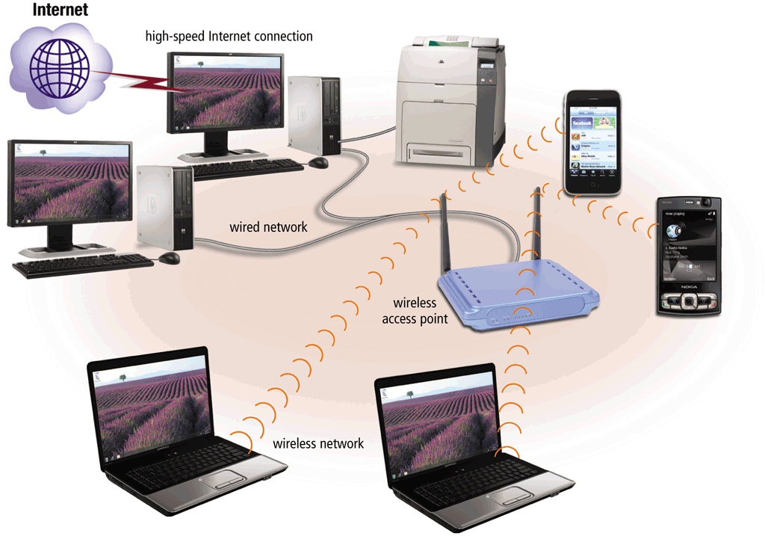
Networks
A local area network (LAN) is a network that connects computers and devices in a limited geographical area
A wireless LAN (WLAN) is a LAN that uses no physical wires
Page 472
Figures 9-10 – 9-11

Slide 24
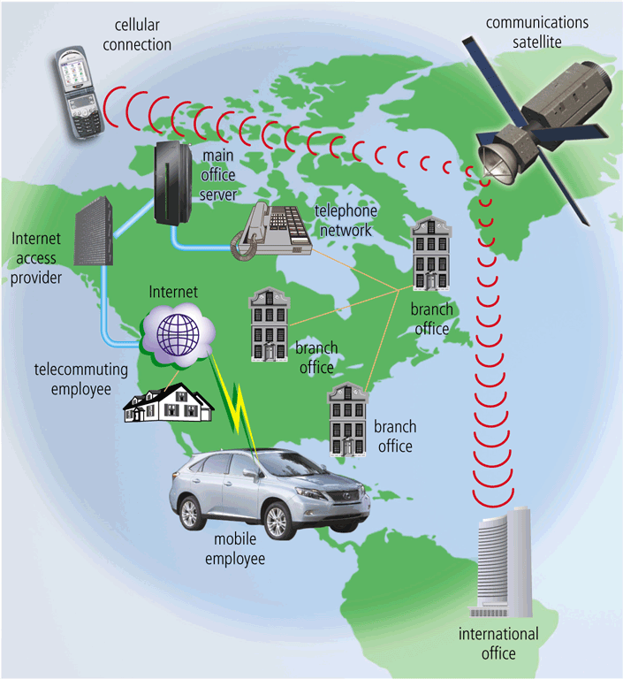
Networks
A metropolitan area network (MAN) connects LANs in a metropolitan area
A wide area network (WAN) is a network that covers a large geographical area
Page 473
Figure 9-12

Slide 25
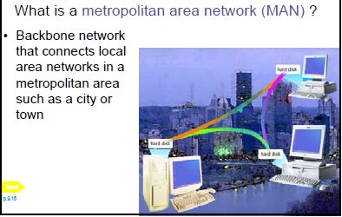
Categories of Network

Slide 26
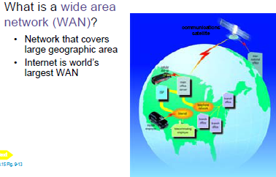
Categories of Network

Slide 27
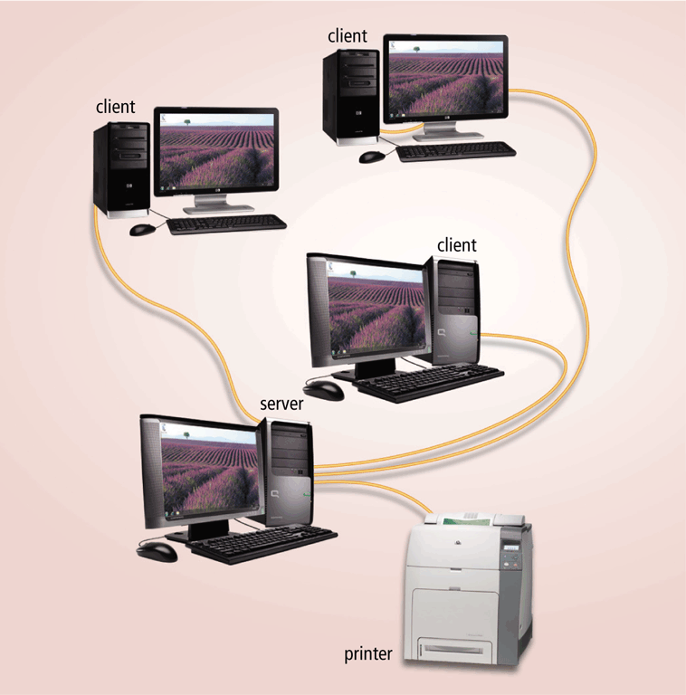
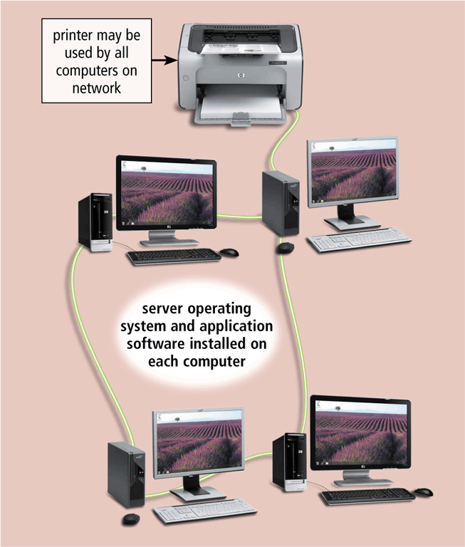
Networks
The design of computers, devices, and media on a network is sometimes called the network architecture
Client/server network
Peer-to-peer network
Pages 473 – 474
Figures 9-13 – 9-14

Slide 28
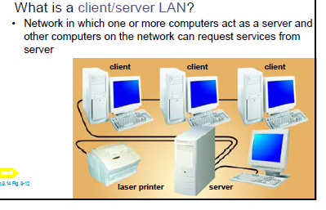
Client/Server Network

Slide 29
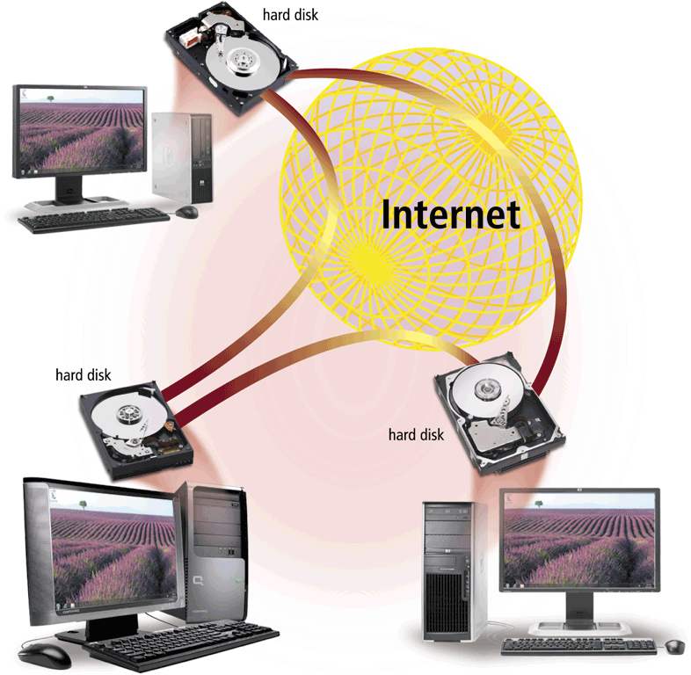
Networks
P2P describes an Internet network on which users access each other’s hard disks and exchange files directly over the Internet
Page 475
Figure 9-15

Slide 30
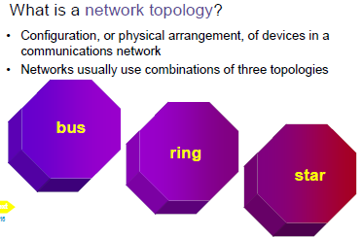
Network Topology

Slide 31
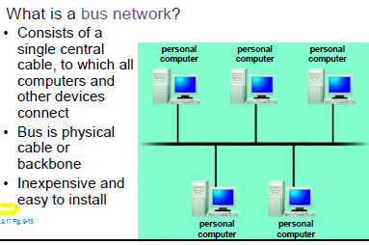
Network Topology

Slide 32
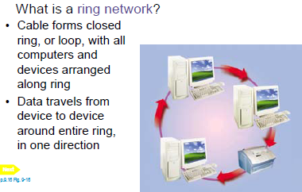
Network Topology

Slide 33
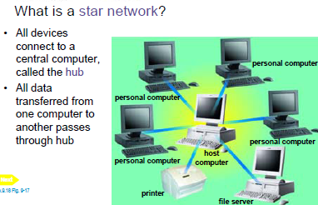
Network Topology

Slide 34
Networks
An intranet is an internal network that uses Internet technologies
An extranet allows customers or suppliers to access part of its intranet
Page 477

Slide 35
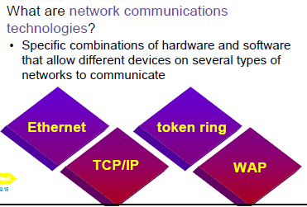
Network Communications Standards

Slide 36
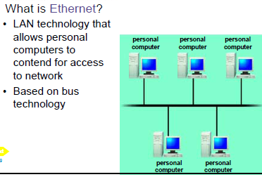
Network Communications Standards

Slide 37
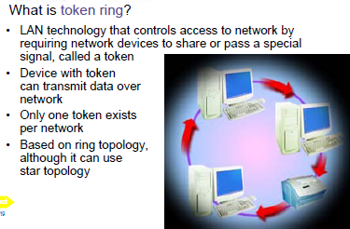
Network Communications Standards

Slide 38
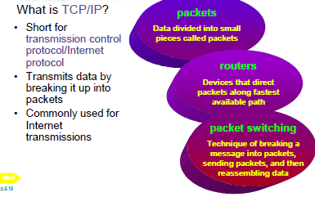
Network Communications Standards

Slide 39
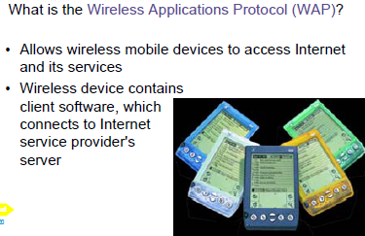
Network Communications Standards

Slide 40
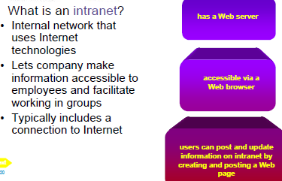
Network Communications Standards

Slide 41
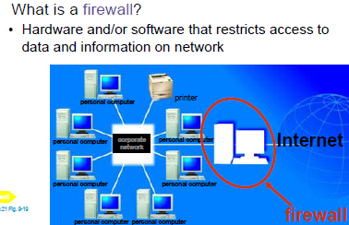
networks

Slide 42
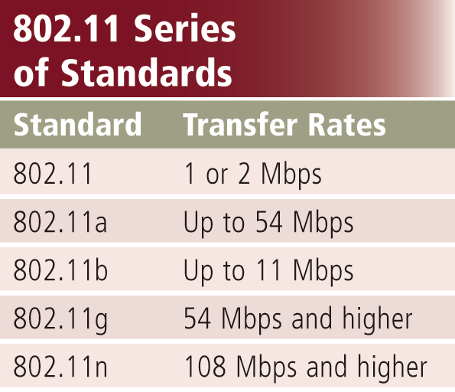
Network Communications Standards
Wi-Fi identifies any network based on the 802.11 standard that facilitates wireless communication
Sometimes referred to as wireless Ethernet
Page 479
Figure 9-20

Slide 43
Network Communications Standards
Bluetooth defines how two Bluetooth devices use short-range radio waves to transmit data
UWB (ultra-wideband) specifies how two UWB devices use short-range radio waves to communicate at high speeds
IrDA transmits data wirelessly via infrared (IR) light waves
RFID uses radio signals to communicate with a tag placed in or attached to an object, animal, or person
Pages 480 - 481

Slide 44
Communications Software
Communications software consists of programs that:
Help users establish a connection to another computer or network
Manage the transmission of data, instructions, and information
Provide an interface for users to communicate with one another
Page 482

Slide 45
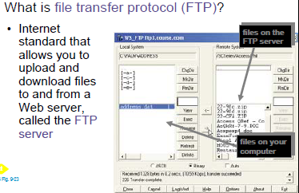
Communications Software

Slide 46
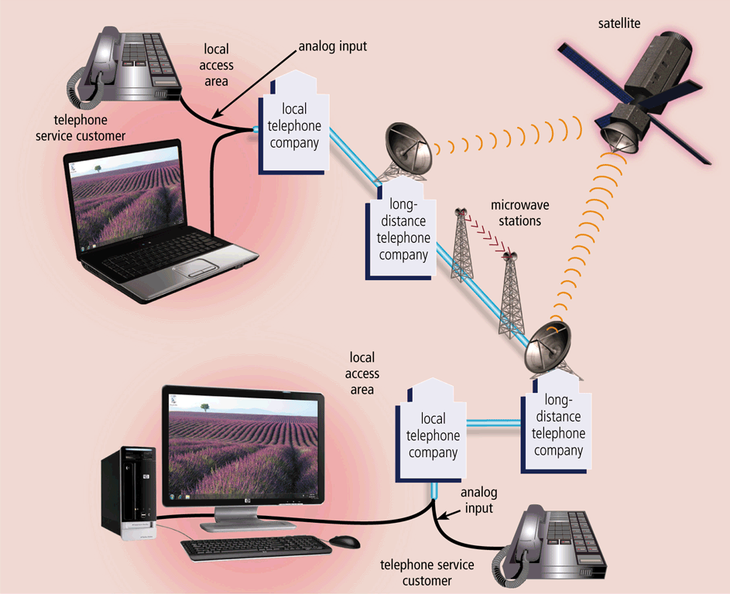
Communications Over the Telephone Network
The public switched telephone network (PSTN) is the worldwide telephone system
Pages 482 – 483
Figure 9-23

Slide 47
Communications Over the Telephone Network
Dial-up lines
Dedicated line
ISDN line
DSL
FTTP
T-carrier line
ATM
Pages 483 - 485

Slide 48
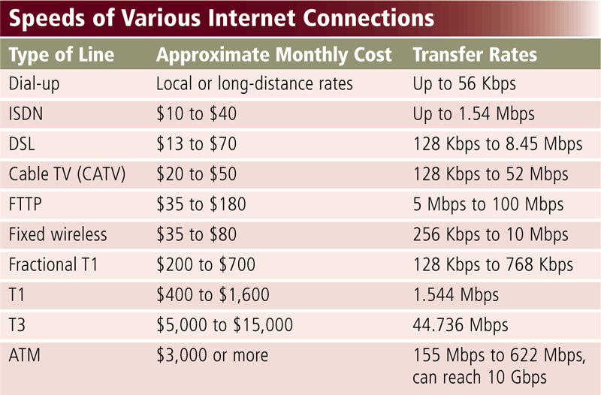
Communications Over the Telephone Network
Page 483
Figure 9-24

Slide 49
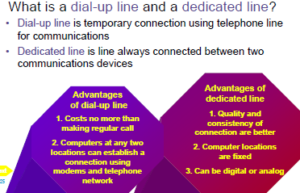
Communications Over the Telephone Network

Slide 50
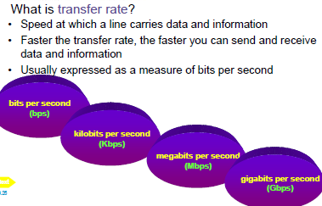

Slide 51
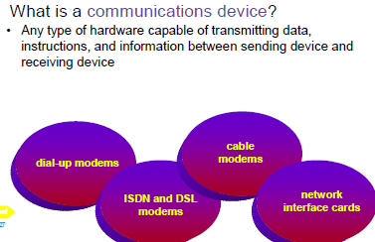
Communications Devices

Slide 52
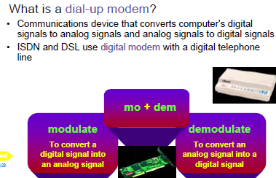
Communications Devices

Slide 53
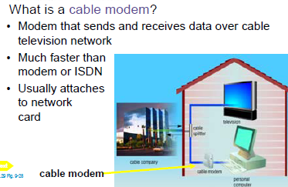
Communications Devices

Slide 54
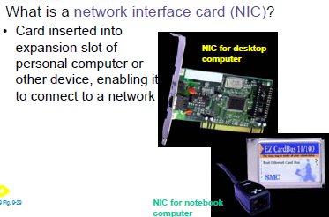
Communications Devices

Slide 55
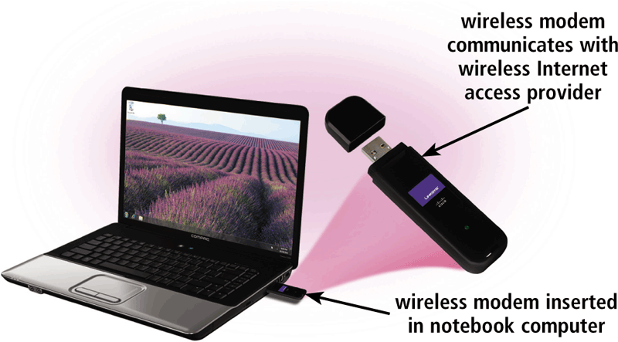
Communications Devices
A wireless modem uses the cell phone network to connect to the Internet wirelessly from a notebook computer, a smart phone, or other mobile device
Page 487
Figure 9-28

Slide 56

Communications Devices
A wireless access point is a central communications device that allows computers and devices to transfer data wirelessly among themselves or to a wired network
Page 487
Figure 9-30

Slide 57
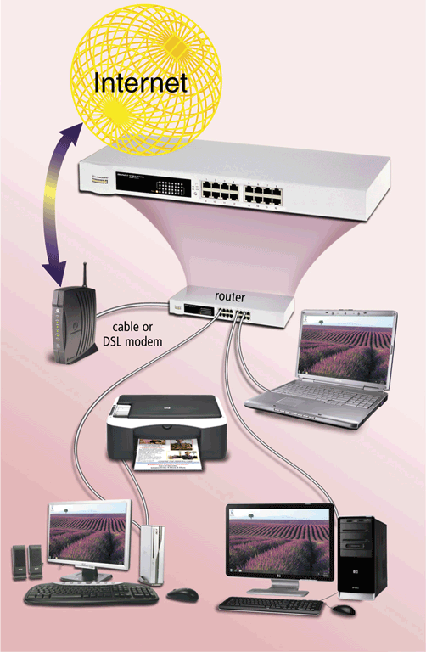
Communications Devices
A router connects multiple computers or other routers together and transmits data to its correct destination on a network
Many are protected by a hardware firewall
Page 488
Figure 9-31

Slide 58
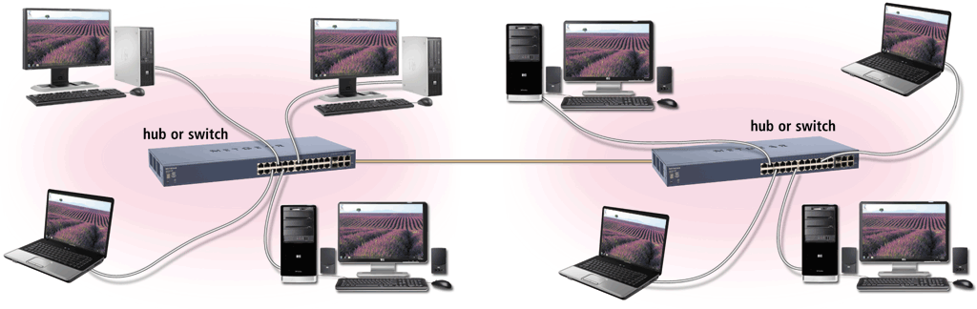
Communications Devices
A hub or switch connects several devices in a network together
Pages 488 – 489
Figure 9-32

Slide 59
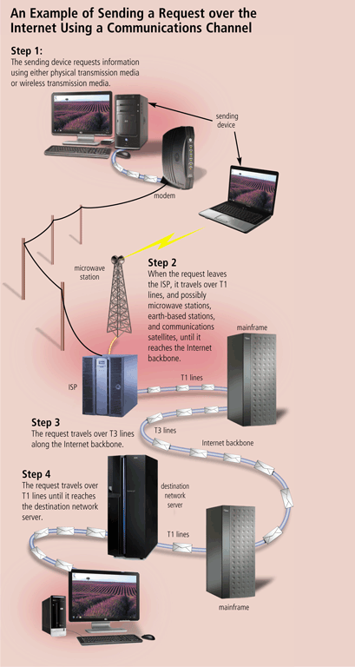
Communications Channel
The amount of data that can travel over a communications channel sometimes is called the bandwidth
Latency is the time it takes a signal to travel from one location to another on a network
Transmission media carries one or more signals
Broadband media transmit multiple signals simultaneously
Page 491
Figure 9-34

Slide 60
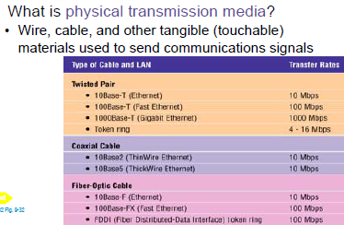
Physical Transmission Media

Slide 61
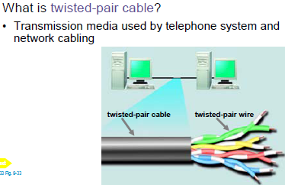
Physical Transmission Media

Slide 62
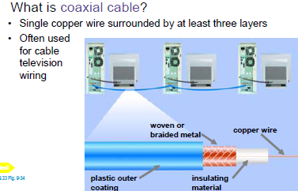
Physical Transmission Media

Slide 63

Physical Transmission Media

Slide 64

Wireless Transmission Media
Cellular radio is a form of broadcast radio that is used widely for mobile communications
Pages 494 - 495
Figure 9-40

Slide 65

Wireless Transmission Media

Slide 66

Wireless Transmission Media

Slide 67

Wireless Transmission Media

Slide 68

Wireless Transmission Media

Slide 69

Wireless Transmission Media
A communications satellite is a space station that receives microwave signals from an earth-based station, amplifies it, and broadcasts the signal over a wide area
Page 496
Figure 9-42

Slide 70
Summary
Overview of communications terminology and applications
How to join computers into a network
Various communications devices, media, and procedures
Page 497

